Slide 1
DYNAMIC MEMORY ALLOCATION IN C++

Slide 2
DMA
A good understanding of how dynamic memory really works in C++ is essential to becoming a good C++ programmer. Memory in your C++ program is divided into two parts:
The stack: All variables declared inside the function will take up memory from the stack.
The heap: This is unused memory of the program and can be used to allocate the memory dynamically when program runs.

Slide 3
PROBLEMS WITH NORMAL ARRAY VARIABLE DECLARATION
Int main() // 1 . Size fixed
{
Int A[5];
Int B[n]; // 2. Error..Size must be known at compile time.
}
Will not work for larger programs because of the limited size of the stack.
1020 | 1022 | 1024 | 1026 | 1028
A[0] | A[1] | A[2] | A[3] | A[4]

Slide 4
New and Delete Operators
Many times, you are not aware in advance how much memory you will need to store particular information in a defined variable and the size of required memory can be determined at run time.
You can allocate memory at run time within the heap for the variable of a given type using a special operator in C++ which returns the address of the space allocated. This operator is called new operator.
If you are not in need of dynamically allocated memory anymore, you can use delete operator, which de-allocates memory previously allocated by new operator.

Slide 5
Dynamic Memory Management
C++ provides a set of operators, called dynamic memory management operators, to allocate & de-allocate memory at execution time, i.e. dynamically.
The memory allocated dynamically, must be de-allocated before your program finishes its execution.
If you run the same program many times, many users are using your program concurrently, the OS may run out of memory.

Slide 6
New Operator
Allocates the memory & always returns a pointer to an appropriate type.
Syntax: -
type * new type [size in integer];
Example: -
int *intPtr;
intPtr = new int [100];

Slide 7
Cont’d
It permits the initialization of memory locations during allocation.
Syntax: -
type *ptrVar = new type (IntialValue);
Example: - int *intPtr = new int (100);
This statement allocates memory for an integer number & initializes it with value 100. The address of the memory allocated memory is assigned to pointer variable intPtr.

Slide 8
Delete Operator
A counterpart of new operator to de-allocates memory allocated by the new operator back to the free poll of memory.
Syntax: -
delete ptrVar;

Slide 9
DEFINING A DYNAMIC ARRAY
When we define an array variable, we specify a type , a name, and a dimension.
int a[2];
When we dynamically allocate an array, we specify the type and size but no name
This new expression allocates an array of ten integers and returns a pointer to the first element in that array, which we use to initialize ptr.
int *ptr = new int[10];
// array of 10 uninitialized integers (contain garbage value)
Objects allocated on the free store are unnamed. We use objects on the heap only indirectly through their address.

Slide 10
To value initialise the array we can use empty parentheses in the expression.
int *pia2 = new int[10] (); // initialized to 0
This effectively send a request to the compiler to value-initialize the array, which in this case sets its elements to 0.
The elements of a dynamically allocated array can be initialized only to the default value of the element type.
The elements cannot be initialized to separate values as can be done for elements of an array variable.
int a[2]={1,2};

Slide 11
int* nums2 = new int[x]; // ok
Value of x is obtained during run time and even the memory allocation is done dynamically
For multidimensional arrays
int x = 3, y = 4;
int* nums3 = new int[x][4][5]; // ok
int* nums4 = new int[x][y][5]; // BAD!
Only the first dimension can be a variable. The rest must be constants.

Slide 12
DEALLOCATING MEMORY
When we allocate memory, we must eventually free it.
Otherwise, memory is gradually used up and may be exhausted
We do so by applying the delete [] expression to a pointer that addresses the array we want to release:
delete ptr; //de allocates the array pointed to by ptr
The empty bracket pair between the delete keyword and the pointer is necessary
It indicates to the compiler that the pointer addresses an array of elements
It is essential to remember the bracket-pair when deleting pointers to arrays.
For every call to new, there must be exactly one call to delete.

Slide 13
EXAMPLE:
#include<iostream>
Using namespace std;
class cls {
int a;
public:
cls() {
a=5;
cout<<"\nConstructor called"; }
~cls()
{ cout<<"\nDestructor called"; }
void disp()
{ cout<<"\na:"<<a; }
};
int main()
{
cls *ptr = new cls;
ptr->disp();
delete ptr;
getch();
}

Slide 14
OUTPUT:
Constructor called
a=5
Destructor called

Slide 15
Memory leak
A memory leak occurs when a piece of memory that was previously allocated by a programmer is not properly deallocated by the programmer
Even though that memory is no longer in use by the program, it is still reserved and the piece of memory cannot be used by the program until it is properly deallocated by the programmer
Char *p,*q
p=new char[10000];
q=new char[50000];
Memory is allocated but not released causing an application to consume memory reducing the available memory for other applications and eventually causing the system to page virtual memory to the hard drive slowing the application or crashing the application when than the computer memory resource limits are reached.

Slide 16
Allocation Failures
Dynamic memory allocation tends to be nondeterministic;
Pointer re-assignment error leads to dangling pointer
Default copy constructor may not give correct results:
Memory Corruption
Buffer overflow:
Heap memory errors:
  Attempting to free memory already freed.
  Freeing memory that was not allocated.
  Attempting to write to memory already freed.
stack (local variables) memory errors:
  Reading/writing to memory out of the bounds of a static array. (array index overflow - index too large/underflow - negative index)
  Function pointer corruption: Invalid passing of function pointer and thus a bad call to a function.

Slide 17
MCQs Time
In C++ ..................... operator is used for Dynamic memory allocation.
Scope resolution
Conditional
New
Membership access
Which of the following operator is used to release the dynamically allocated memory in CPP?
a. remove
b. free
c. delete
d. both b and c

Slide 18
Polymorphism
&
Virtual Functions

Slide 19
Polymorphism
Combination of poly & morphism
        many forms
Allows defining various forms of a single function that can be shared by various objects to perform the identical operations.
Implemented at compile & run time.
        function overloading virtual functions
        & operator overloading

Slide 20
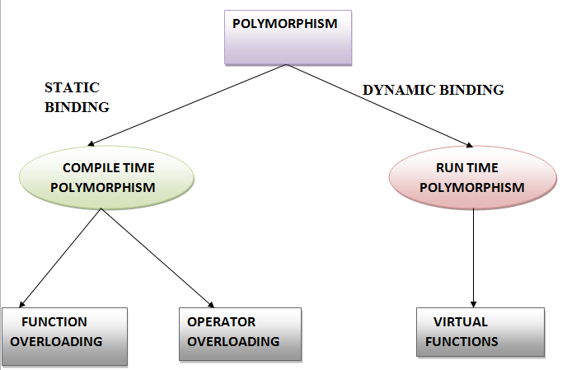
Polymorphism

Slide 21
Cont’d
Binding is the process of tying the function call to function definition. Binding refers to the process that is used to convert identifiers (such as variable and function names) into machine language addresses.
  Although binding is used for both variables and functions, in this lesson we’re going to focus on function binding.
When binding happens at compile time → “early binding”.
When binding happens at run time → “late binding”.

Slide 22
Static Binding/Early Binding
Most of the function calls the compiler encounters will be direct function calls. A direct function call is a statement that directly calls a function. For example:
#include <iostream>
void Print(int n)
{ cout << n; }
int main()
{ Print(5); // This is a direct function call
return 0; }

Slide 23
Explanation
Direct function calls can be resolved using a process known as early binding.
Early binding (also called static binding) means the compiler is able to directly associate the identifier name (such as a function or variable name) with a machine address.
Note: Remember that all functions have a unique machine address. So when the compiler encounters a function call, it replaces the function call with a machine language instruction that tells the CPU to jump to the address of the function.

Slide 24
Dynamic Binding
In some programs, it is not possible to know which function will be called until runtime (when the program is run). This is known as late binding (or dynamic binding).
In C++, one way to get late binding is to use function pointers.
To review function pointers briefly, a function pointer is a type of pointer that points to a function instead of a variable. The function that a function pointer points to can be called by using the function call operator (()) on the pointer.

Slide 25
Polymorphism Summary:
When you use virtual functions, compiler store additional information about the types of object available and created
Polymorphism is supported at this additional overhead
Important :
  virtual functions work only with pointers/references
  Not with objects even if the function is virtual
  If a class declares any virtual methods, the destructor of the class should be declared as virtual as well.

Slide 26
Syntax
class sampleclass
{
private:
::::::::::: //data members of the class
public:
::::::::::: //function members of the class
virtual ReturnType FunctionName (arg)
{
:::::::::::: //body of the virtual function
}
};

Slide 27
Cont’d
To implement run time polymorphism, you need to make a function virtual & access the virtual function through pointer to the base class.
A function in a class is preceded by virtual becomes virtual function.

Slide 28
Virtual Functions
A member function whose function declaration is preceded by virtual keyword → “virtual function”.
These functions are defined in a base class in the public section & they provide a mechanism by which the derived classes can override it.
virtual member function in any derived class
this is called overriding
  understand the contrast with overloading

Slide 29
Example
class A {
public:
virtual void f() { cout << "Class A" << endl; }
};
class B: public A {
public:
void f(int) { cout << "Class B" << endl; }
};
class C: public B {
public:
void f() { cout << "Class C" << endl; }
};

Slide 30
Output
int main() {
B b; C c;
A* pa1 = &b;
A* pa2 = &c;
// b.f();
pa1->f();
pa2->f();
}
Outputs:
Class A
Class C

Slide 31
Pure Virtual Functions & Abstract Classes
A virtual function without a body → “pure virtual function” or “do nothing function”.
A class with at least one pure virtual function → “abstract class”.
Syntax:- Pure Virtual Function
class sampleclass
{ private:
::::::::::: //data members of the class
public:
::::::::::: //function members of the class
virtual ReturnType FunctionName (arg) = 0;
};

Slide 32
Pure Virtual Functions & Abstract Classes
Some classes exist logically but not physically.
Example : Shape
  Shape s; // Legal but silly..!! : “Shapeless shape”
  Shape makes sense only as a base of some classes derived from it. Serves as a “category”
  Hence instantiation of such a class must be prevented
class Shape //Abstract
{
public :
//Pure virtual Function
virtual void draw() = 0;
}
A class with one or more pure virtual functions is an Abstract Class. Objects of abstract class can’t be created
Shape s; // error : variable of an abstract class

Slide 33
Example
Shape
virtual void draw()
Circle
Triangle
public void draw()
public void draw()

Slide 34
A pure virtual function not defined in the derived class remains a pure virtual function.
Hence derived class also becomes abstract
class Circle : public Shape { //No draw() - Abstract
public :
void print(){
cout << “I am a circle” << endl;
}
class Rectangle : public Shape {
public :
void draw(){ // Override Shape::draw()
cout << “Drawing Rectangle” << endl;
}
Rectangle r; // Valid
Circle c; // error : variable of an abstract class

Slide 35
Virtual Destructors
We can have virtual destructors but not virtual constructors.
Hence, by making the destructor in the base class virtual, we ensure that the derived class destructor gets called before the base class destructor.
Problem:
  If base-class pointer to a derived object is deleted, the base-class destructor will act on the object
Solution:
  Declare a virtual base-class destructor
  Now, the appropriate destructor will be called

Slide 36
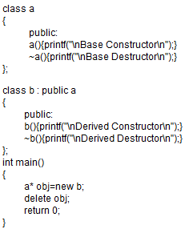
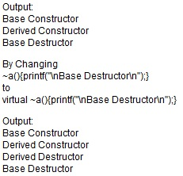
PROBLEM: The destructor for the “b" class does not get called at all when we delete ‘obj’.
How can we fix this problem?

Slide 37
Can static functions be virtual in C++?
In C++, a static member function of a class cannot be virtual. For example, below program gives compilation error.
#include<iostream>
using namespace std;
class Test
{ public:
virtual static void fun() { }
};
// Error: Virtual member functions cannot be static

Slide 38
Cont’d
Also, static member function cannot be const and volatile. Following code also fails in compilation.
#include<iostream>
using namespace std;
class Test
{ public:
static void fun() const { }
};
// Error: Static member function cannot be const

Slide 39
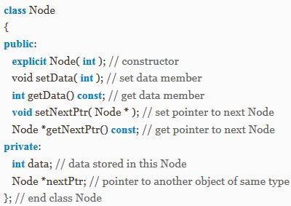
Self-referential classes
A self-referential class contains a member that points to a class object of the same class type. For example, the definition:

Slide 40
MCQs
1) Syntax for Pure Virtual Function is ______________ .
a. virtual void show()==0
b. void virtual show()==0
c. virtual void show()=0
d. void virtual show()=0
2) Run time polymorphism can be achieved with______ .
a. Virtual Base class
b. Container class
c. Virtual function
d. Both a and c

Slide 41
MCQs
3) _______________ is a member function that is declared within a base class and redefined by derived class.
a. virtual function
b. static function
c. friend function
d. const member function
4) Find the wrong statement/s about Abstract Class.
a. We can’t create its objects.
b. We can’t create pointers to an abstract class.
c. It contains at least one pure virtual function.
d. We can create references to an abstract class.

Slide 42
MCQs
5) Which of the followings are true about Virtual functions?
a. They must be non-static member function of the class
b. They cannot be friends
c. Constructor Functions cannot be virtual
d. All of these
6) When a virtual function is redefined by the derived class, it is called___________.
a. Overloading b. Overriding
c. Rewriting d. All of these
7) If a class contains pure virtual function, then it is termed as____________________ .
a. Virtual class b. Sealed class
c. Pure Local class d. Abstract Class

Slide 43
WAP using abstract classes to find the area of rectangle and triangle.
WAP to display the record for an engine with various coaches using linked list.

Slide 44
Thank You!!!

